Slide 1
Maxwell: Project Proposal
Jake Neal—Project Manager
Cameron Shea—Assistant Project Manager
Adam Paugh
Farris Hejazen
Peyton Nelson
Dr. Thad Roppel—ECE

Slide 2
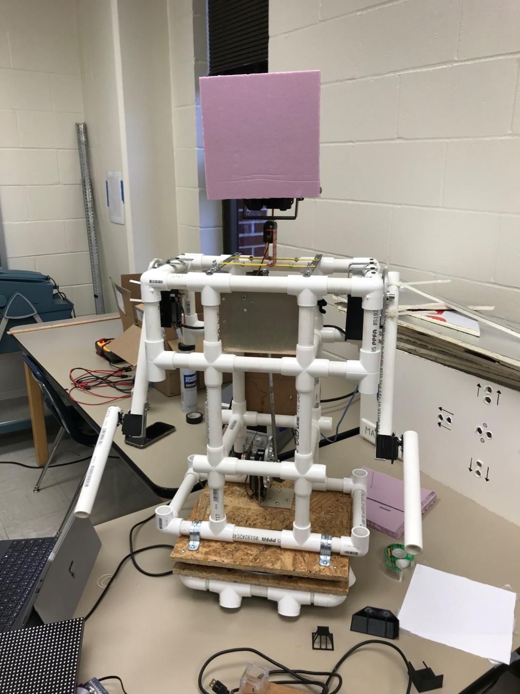
Overview
Initial Goals
Where We Are
Looking Ahead
Timeline
Demonstration and Questions
Current Prototype of Maxwell

Slide 3
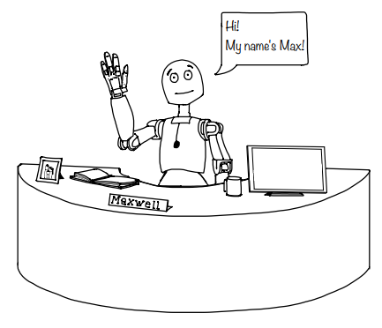
Initial Goals
Safety and Information Kiosk for Broun Hall
Safety Features
Acoustic Surveillance
Blue Light
Fire and Weather Advisory Guidance
Animatronic Figure
Interactive Interface
Directions
Safety Information
E-Day, Gameday, Camp War Eagle Demonstrations
Original Concept Art of Maxwell

Slide 4
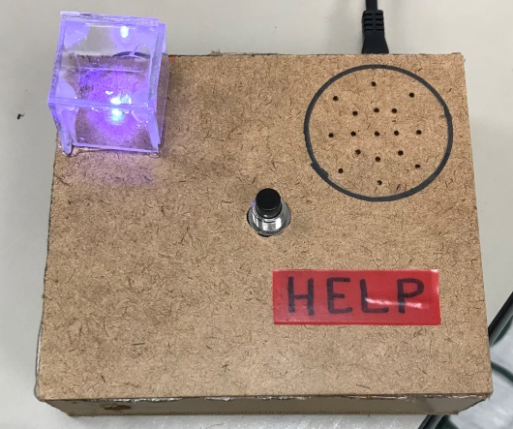
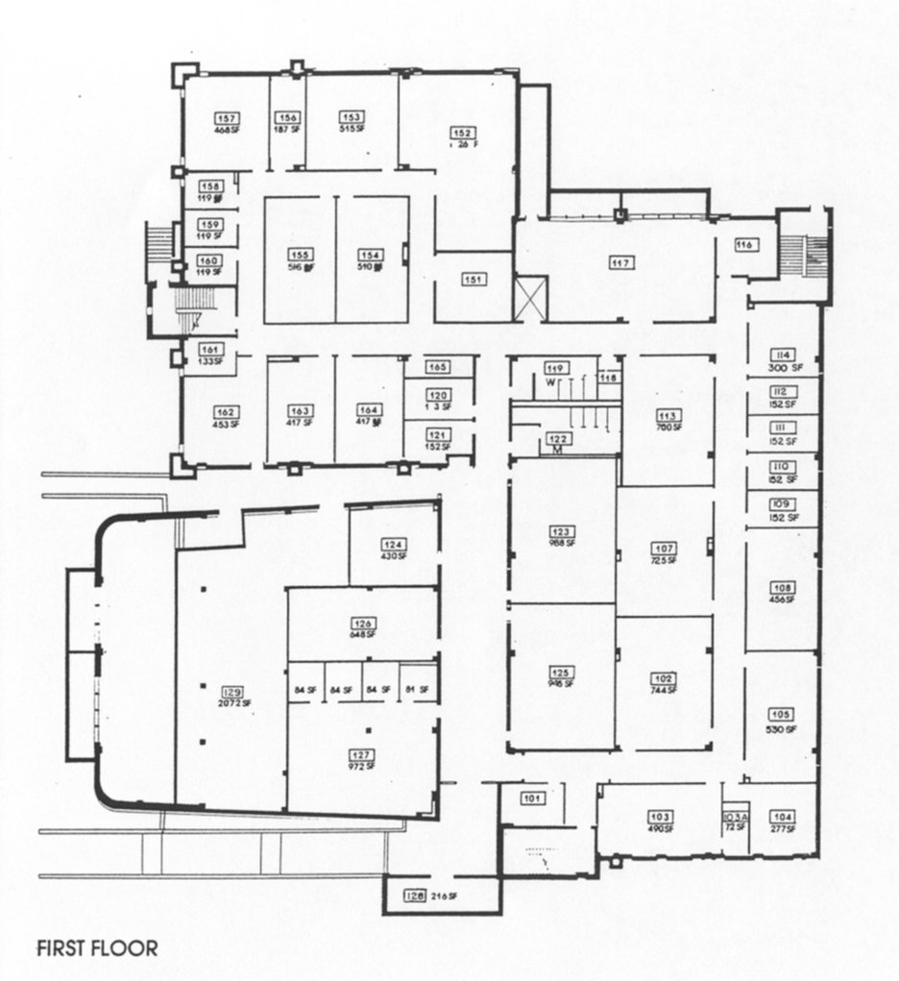
Safety Features
Blue Light
Small scale representation of having a real Blue Light station
Acoustic Surveillance
Currently a threshold sensor for concept
Weather and Fire Alerts
Evacuation routes and Severe Weather Shelter Areas have been mapped

Slide 5
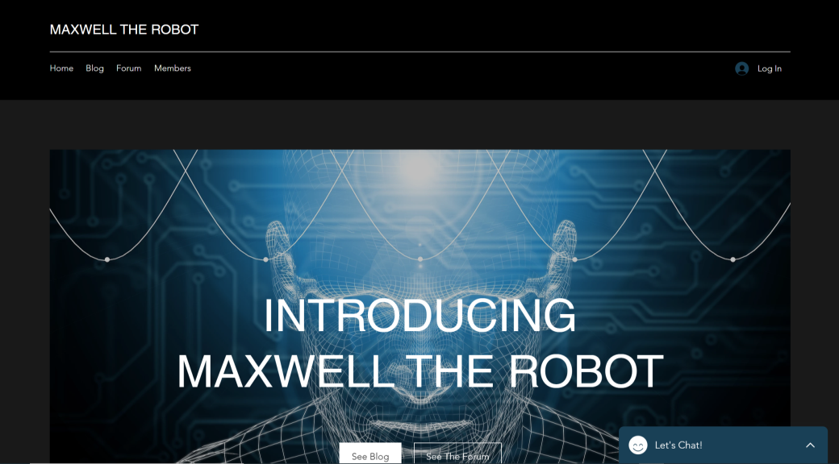
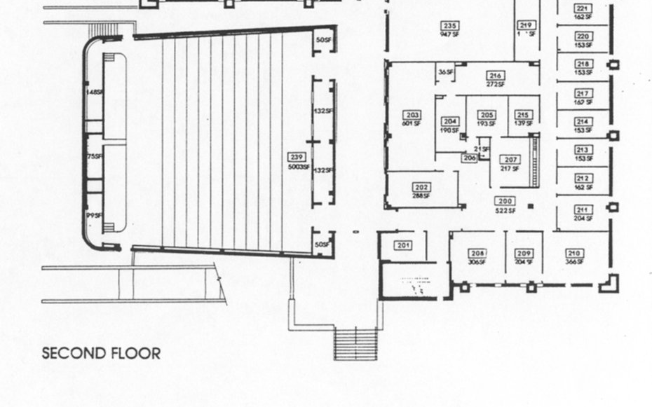
Direction and Information
GUI (Graphical User Interface)
Sample window created
Direction Mapping
We have a directory of each professor’s room number

Slide 6
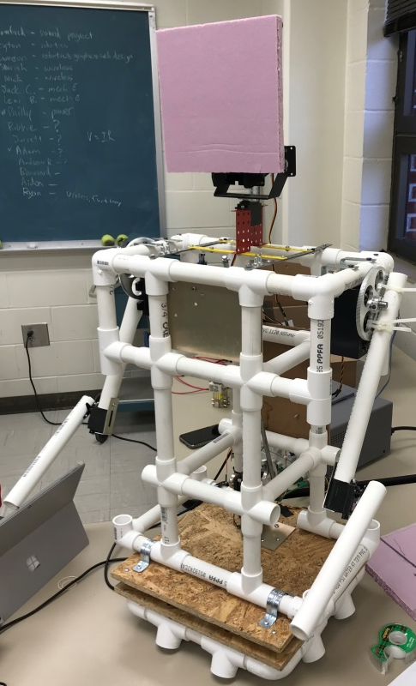
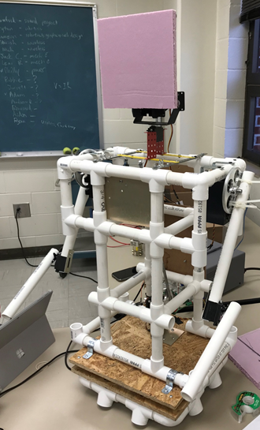
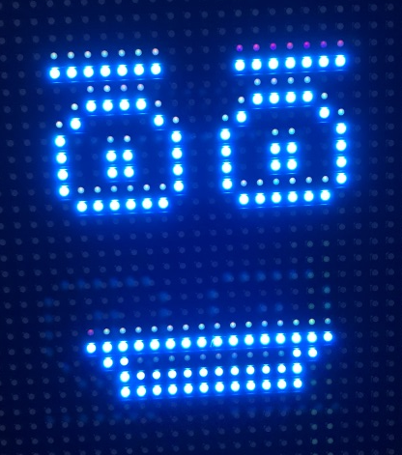
Animatronic
Degrees of Freedom
Enough for initial testing, but anticipating full human range
Face
Hardware acquired and tested
Software
Individual systems are created but not integrated
Voice
Currently have demo recordings by Farris
Desk
Foam model for scale testing

Slide 7
What’s Next?
Integrating all the current systems
Raspberry Pi can run the operations of the GUI and physical systems
Arduino can handle hardware operation under direction from the Pi
Beginning collaboration with Campus Safety
Blue Light, AU Alert, etc…

Slide 8
Timeline
Hard to put chronologically
Most aspects will be worked on at the same time by multiple team members
Some features may need to be postponed until other features are completed
Fully Functional Maxwell by May of 2020
Mechanical aspects of the figure
Finished by the end of the Fall semester
Aesthetic details be added in Spring semester
Face
1 month for voice/mouth software
2-3 weeks for other facial movements
Desk
2-3 weeks once materials are purchased
Campus Safety Integration (Blue Light, AU Alert, etc.)
3+ Months
This will vary based on how much/often we need to meet with Campus Safety consultants

Slide 9
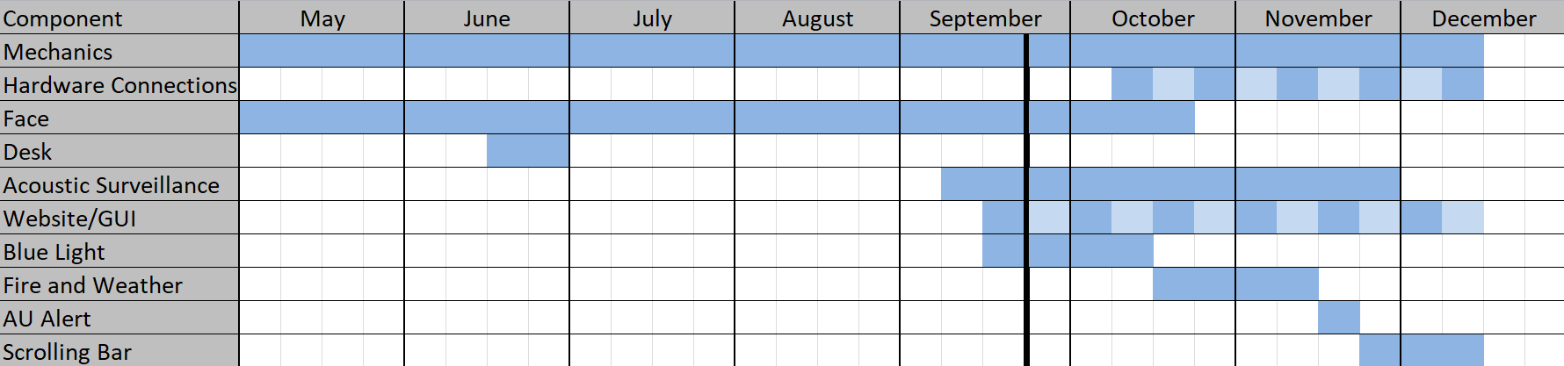
Timeline Continued
Fully Functional Maxwell by May of 2020
Connecting the Raspberry Pi to the Arduino
1 week
GUI/Website
2-3 months depending on how many team members are involved
Acoustic Surveillance
4+ months
There is a lot of needed research, development, and testing

Slide 10
Budget
UMA-8-SP: $95.00
600W UPS: $120.00
Website Costs: $50.00
Light Diffusers: $30.00
Servos: $1000.00
Robot cladding: $200.00
Safety Features: $1000
_____________________
Totals: $2,495
Available left for unexpected costs: $505
Any leftover funds will be redistributed to the respective department the funding came from

Slide 11
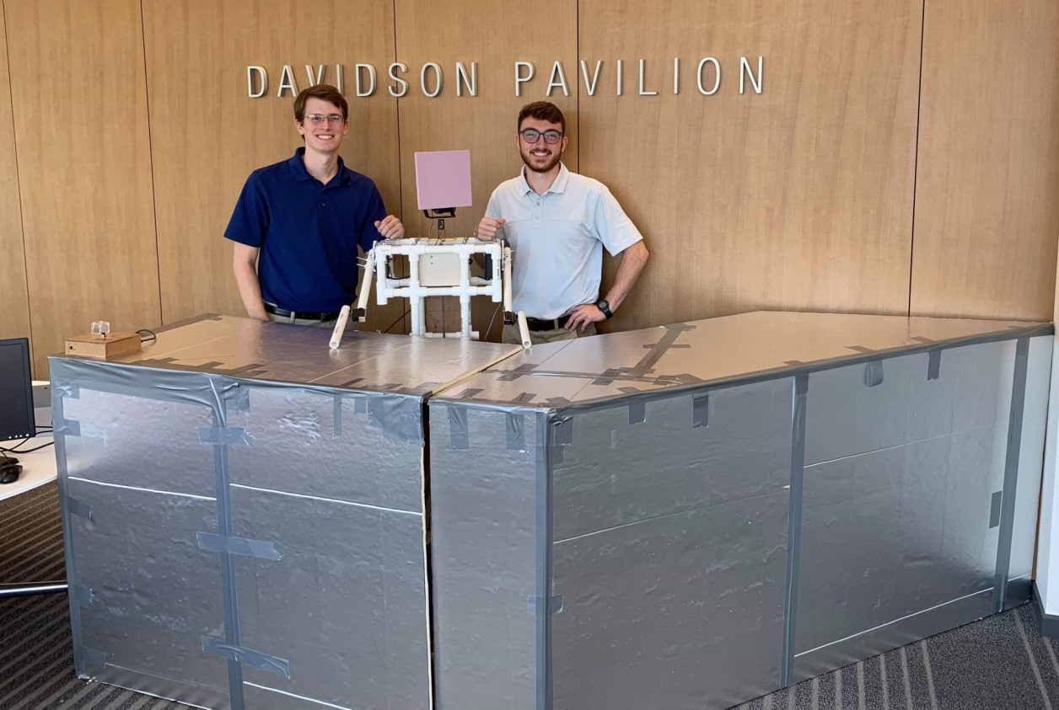
Demonstration
Currently four displays (one to be shown)
Greeting
Blue Light Activity
Fire Alarm
Weather Alert
Show basic movement of the figure
Demonstrate the safety feature prototypes
Capability to write predetermined scripts
Different responses based on different stimuli
Currently using programming (individual Arduino scripts) as triggers
This will be replaced when the systems (blue light, GUI, etc.) are integrated

